Slide 1
Neural Networks
Overview
Neurons
Activation
MLP Architecture
Loss Functions
Network Training

Slide 2
Overview
Traditionally designed to handle classification as well as regression tasks
Historically, training was computationally expensive
Renewed interest because of reduction in computing cost
Will focus on the most basic neural network architecture

Slide 3
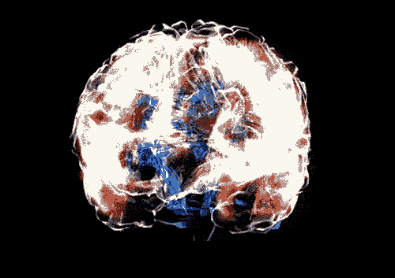
Neurons: Biological

Slide 4
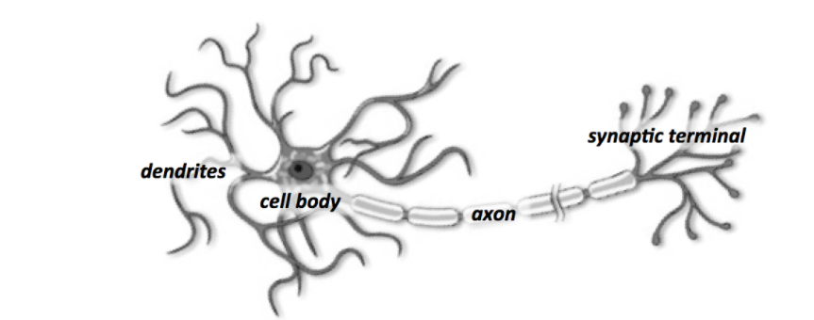
Neurons: Biological

Slide 5
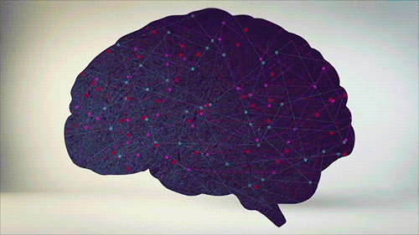
Neurons: Biological

Slide 6
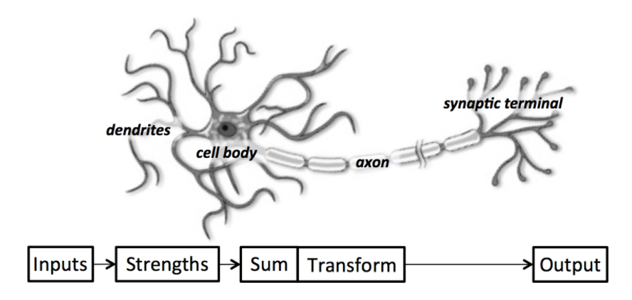
Neurons: Biological

Slide 7
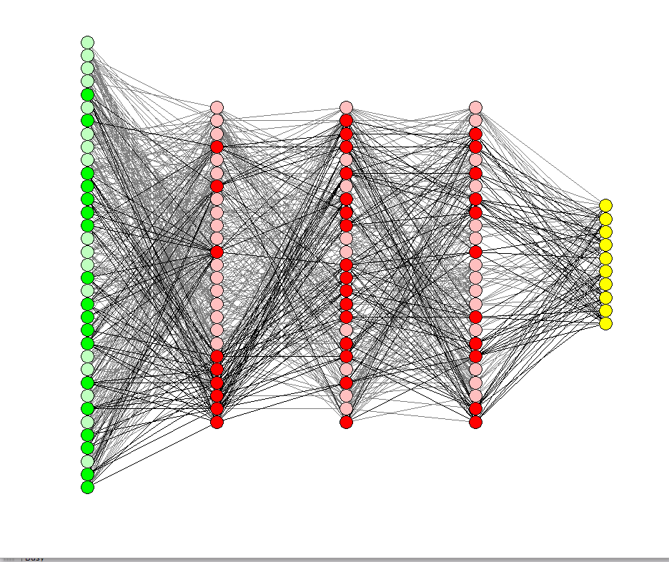
Neurons: Artificial

Slide 8
Neurons: Artificial

Slide 9
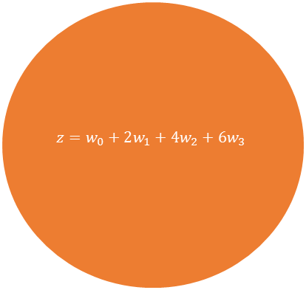
Neurons: Artificial
2
$$z=w_{0}+2w_{1}+4w_{2}+6w_{3}$$
w1
McCulloch-Pitts Neuron
4
w2
Inputs
w3
6

Slide 10
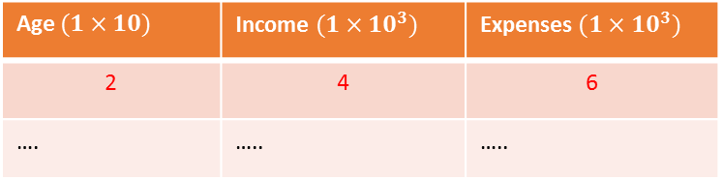
Neurons: Artificial
2
Age $(1×10)$ | Income $(1×10^{3})$ | Expenses $(1×10^{3})$
2 | 4 | 6
…. | ….. | …..
$$z=w_{0}+2w_{1}+4w_{2}+6w_{3}$$
w1
4
w2
Inputs
w3
6

Slide 11
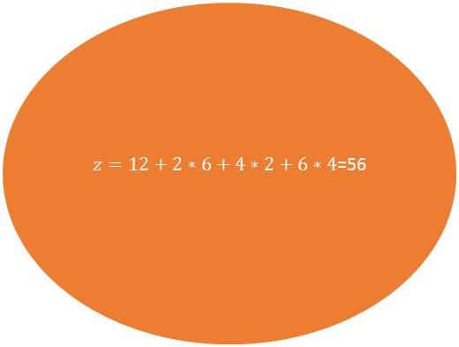
Neurons: Artificial
2
$z=12+2∗6+4∗2+6∗4$=56
6
4
2
Inputs
4
6

Slide 12
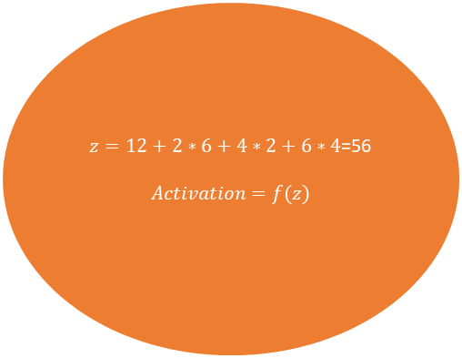
Neurons: Artificial
2
$$z=12+2∗6+4∗2+6∗4\text{=56}$$
$$Activation=f(z)$$
w1=6
4
w2=2
Inputs
w3=4
6

Slide 13
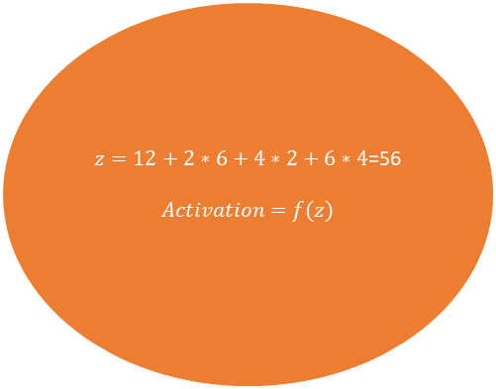
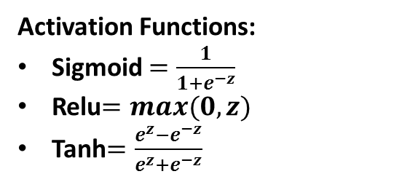
Neurons: Artificial
2
$$z=12+2∗6+4∗2+6∗4\text{=56}$$
$$Activation=f(z)$$
w1=6
Activation Functions:
Sigmoid $=\frac{1}{{1+e}^{−z}}$
Relu$=max(0,z)$
Tanh$=\frac{e^{z}−e^{−z}}{e^{z}+e^{−z}}$
4
w2=2
Inputs
w3=4
6

Slide 14
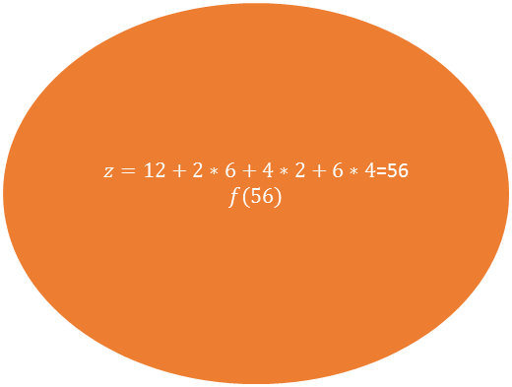
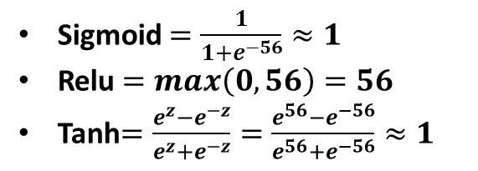
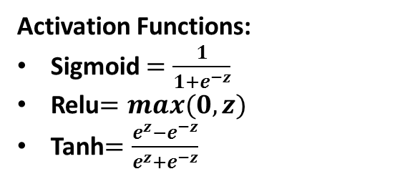
Neurons: Artificial
2
$z=12+2∗6+4∗2+6∗4$=56
$$f(56)$$
6
Activation Functions:
Sigmoid $=\frac{1}{{1+e}^{−z}}$
Relu$=max(0,z)$
Tanh$=\frac{e^{z}−e^{−z}}{e^{z}+e^{−z}}$
4
2
Inputs
4
Sigmoid $=\frac{1}{1+e^{−56}}≈1$
Relu $=max\left(0,56\right)=56$
Tanh$=\frac{e^{z}−e^{−z}}{e^{z}+e^{−z}}=\frac{e^{56}−e^{−56}}{e^{56}+e^{−56}}≈1$
6

Slide 15
Neurons: Artificial

Slide 16
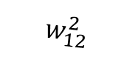
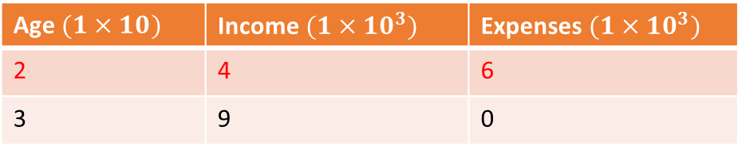
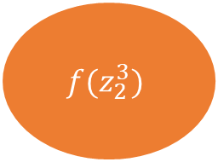
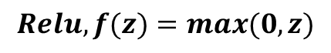
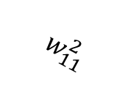
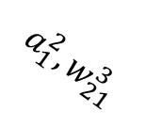
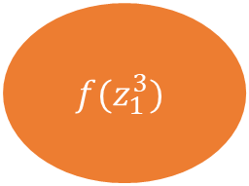
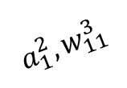
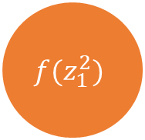
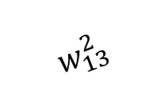
Neuron: Artificial
Age $(1×10)$ | Income $(1×10^{3})$ | Expenses $(1×10^{3})$
2 | 4 | 6
3 | 9 | 0
2
$$w_{11}^{2}$$
$$f(z_{1}^{3})$$
$$Relu, f(z)=max(0,z)$$
$$a_{1}^{2}, w_{11}^{3}$$
4
$$w_{12}^{2}$$
$$f(z_{1}^{2})$$
$$a_{1}^{2}, w_{21}^{3}$$
$$w_{13}^{2}$$
6
$$f(z_{2}^{3})$$

Slide 17
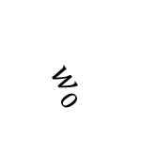
Neuron: Artificial
Age $(1×10)$ | Income $(1×10^{3})$ | Expenses $(1×10^{3})$
2 | 4 | 6
3 | 9 | 0
$$w_{0}$$
2
$$w_{11}^{2}$$
$$f(z_{1}^{3})$$
$$Relu, f(z)=max(0,z)$$
$$a_{1}^{2}, w_{11}^{3}$$
4
$$w_{12}^{2}$$
$$f(z_{1}^{2})$$
$$a_{1}^{2}, w_{21}^{3}$$
$$w_{13}^{2}$$
6
$$z_{1}^{2}=w_{0}+x1∗w_{1}+x2∗w_{2}+x3∗w_{3}$$
$$f(z_{2}^{3})$$

Slide 18
Neuron: Artificial
Age $(1×10)$ | Income $(1×10^{3})$ | Expenses $(1×10^{3})$
2 | 4 | 6
3 | 9 | 0
0.1
2
0.2
$$f(z_{1}^{3})$$
$$Relu, f(z)=max(0,z)$$
$$a_{1}^{2}, w_{11}^{3}$$
4
-0.5
$$f(z_{1}^{2})$$
$$a_{1}^{2}, w_{21}^{3}$$
1
6
$$z_{1}^{1}=w_{0}+x1∗w_{1}+x2∗w_{2}+x3∗w_{3}$$
$$f(z_{2}^{3})$$

Slide 19
Neuron: Artificial
Age $(1×10)$ | Income $(1×10^{3})$ | Expenses $(1×10^{3})$
2 | 4 | 6
3 | 9 | 0
0.1
2
0.2
$$f(z_{1}^{3})$$
$$Relu, f(z)=max(0,z)$$
$$a_{1}^{2}, w_{11}^{3}$$
4
-0.5
$$f(z_{1}^{2})$$
$$a_{1}^{2}, w_{21}^{3}$$
1
6
$$z_{1}^{2}=w_{0}+x1∗w_{1}+x2∗w_{2}+x3∗w_{3}$$
$$f(z_{2}^{3})$$
$$z_{1}^{2}=0.1+2∗0.2+4∗\left(−0.5\right)+6∗1$$

Slide 20
Neuron: Artificial
Age $(1×10)$ | Income $(1×10^{3})$ | Expenses $(1×10^{3})$
2 | 4 | 6
3 | 9 | 0
0.1
2
0.2
$$f(z_{1}^{3})$$
$$Relu, f(z)=max(0,z)$$
$$a_{1}^{2}, w_{11}^{3}$$
4
-0.5
$$f(z_{1}^{2})$$
$$a_{1}^{2}, w_{21}^{3}$$
1
6
$$z_{1}^{2}=w_{0}+x1∗w_{1}+x2∗w_{2}+x3∗w_{3}$$
$$f(z_{2}^{3})$$
$$z_{1}^{2}=0.1+2∗0.2+4∗\left(−0.5\right)+6∗1$$
$$z_{1}^{2}=4.5$$

Slide 21
Neuron: Artificial
Age $(1×10)$ | Income $(1×10^{3})$ | Expenses $(1×10^{3})$
2 | 4 | 6
3 | 9 | 0
0.1
2
0.2
$$f(z_{1}^{3})$$
$$Relu, f(z)=max(0,z)$$
$$a_{1}^{2}, w_{11}^{3}$$
4
-0.5
$$f(z_{1}^{2})$$
$$a_{1}^{2}, w_{21}^{3}$$
1
6
$$z_{1}^{2}=w_{0}+x1∗w_{1}+x2∗w_{2}+x3∗w_{3}$$
$$f(z_{2}^{3})$$
$$z_{1}^{2}=0.1+2∗0.2+4∗\left(−0.5\right)+6∗1$$
$$z_{1}^{2}=4.5$$
$$f\left(z_{1}^{2}\right)=f\left(4.5\right)=max\left(0,4.5\right)=4.5$$

Slide 22
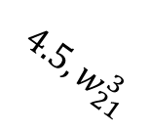

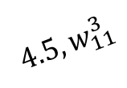
Neuron: Artificial
Age $(1×10)$ | Income $(1×10^{3})$ | Expenses $(1×10^{3})$
2 | 4 | 6
3 | 9 | 0
0.1
2
0.2
$$f(z_{1}^{3})$$
$$Relu, f(z)=max(0,z)$$
$$4.5, w_{11}^{3}$$
4
-0.5
$$f(z_{1}^{2})$$
$$z_{1}^{2}=w_{0}+w_{1}∗x_{1}$$
$$4.5, w_{21}^{3}$$
1
6
$$z_{1}^{2}=w_{0}+x1∗w_{1}+x2∗w_{2}+x3∗w_{3}$$
$$f(z_{2}^{3})$$
$$z_{1}^{2}=0.1+2∗0.2+4∗\left(−0.5\right)+6∗1$$
$$z_{1}^{1}=4.5$$
$$f\left(z_{1}^{2}\right)=f\left(4.5\right)=max\left(0,4.5\right)=4.5$$

Slide 23
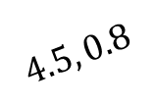

Neuron: Artificial
Age $(1×10)$ | Income $(1×10^{3})$ | Expenses $(1×10^{3})$
2 | 4 | 6
3 | 9 | 0
0.1
2
0.2
$$f(z_{1}^{3})$$
$$Relu, f(z)=max(0,z)$$
$$4.5, 0.8$$
4
-0.5
$$f(z_{1}^{2})$$
$$z_{1}^{3}=0.2+0..8∗x_{1}$$
$$4.5, w_{21}^{3}$$
1
6
$$z_{1}^{2}=w_{0}+x1∗w_{1}+x2∗w_{2}+x3∗w_{3}$$
$$f(z_{2}^{3})$$
$$z_{1}^{2}=0.1+2∗0.2+4∗\left(−0.5\right)+6∗1$$
$$z_{1}^{2}=4.5$$
$$f\left(z_{1}^{2}\right)=f\left(4.5\right)=max\left(0,4.5\right)=4.5$$

Slide 24
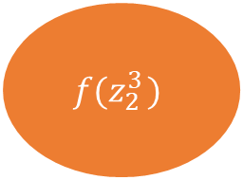

Neuron: Artificial
Age $(1×10)$ | Income $(1×10^{3})$ | Expenses $(1×10^{3})$
2 | 4 | 6
3 | 9 | 0
0.1
2
0.2
$$f(z_{1}^{3})$$
$$Relu, f(z)=max(0,z)$$
$$4.5, 0.8$$
4
-0.5
$$f(z_{1}^{2})$$
$$z_{1}^{3}=0.2+0..8∗4.5$$
$$4.5, w_{21}^{3}$$
1
6
$$z_{1}^{2}=w_{0}+x1∗w_{1}+x2∗w_{2}+x3∗w_{3}$$
$$f(z_{2 }^{3})$$
$$z_{1}^{2}=0.1+2∗0.2+4∗\left(−0.5\right)+6∗1$$
$$z_{1}^{2}=4.5$$
$$f\left(z_{1}^{2}\right)=f\left(4.5\right)=max\left(0,4.5\right)=4.5$$

Slide 25

Neuron: Artificial
Age $(1×10)$ | Income $(1×10^{3})$ | Expenses $(1×10^{3})$
2 | 4 | 6
3 | 9 | 0
0.1
2
0.2
$$f(z_{1}^{3})$$
$$Relu, f(z)=max(0,z)$$
$$4.5, 0.8$$
4
-0.5
$$f(z_{1}^{2})$$
$$z_{1}^{3}=0.2+0..8∗4.5$$
$$4.5, w_{21}^{3}$$
$$z_{1}^{3}=3.8$$
1
6
$$z_{1}^{2}=w_{0}+x1∗w_{1}+x2∗w_{2}+x3∗w_{3}$$
$$f(z_{2}^{3})$$
$$z_{1}^{2}=0.1+2∗0.2+4∗\left(−0.5\right)+6∗1$$
$$z_{1}^{2}=4.5$$
$$f\left(z_{1}^{2}\right)=f\left(4.5\right)=max\left(0,4.5\right)=4.5$$

Slide 26


Neuron: Artificial
Age $(1×10)$ | Income $(1×10^{3})$ | Expenses $(1×10^{3})$
2 | 4 | 6
3 | 9 | 0
0.1
2
0.2
$$f(z_{1}^{3})$$
$$Relu, f(z)=max(0,z)$$
$$4.5, 0.8$$
4
-0.5
$$f(z_{1}^{2})$$
$$z_{1}^{3}=0.2+0..8∗4.5$$
$$4.5, w_{21}^{3}$$
$$z_{1}^{3}=3.8$$
1
$$f\left(z_{1}^{3}\right)=f\left(3.8\right)=max\left(0,3.8\right)=3.8$$
6
$$z_{1}^{2}=w_{0}+x1∗w_{1}+x2∗w_{2}+x3∗w_{3}$$
$$f(z_{2}^{3})$$
$$z_{1}^{2}=0.1+2∗0.2+4∗\left(−0.5\right)+6∗1$$
$$z_{1}^{2}=4.5$$
$$f\left(z_{1}^{2}\right)=f\left(4.5\right)=max\left(0,4.5\right)=4.5$$

Slide 27
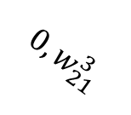
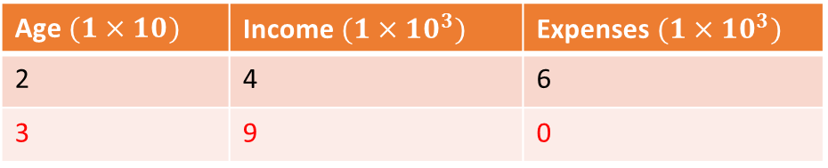
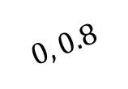



Neuron: Artificial
Age $(1×10)$ | Income $(1×10^{3})$ | Expenses $(1×10^{3})$
2 | 4 | 6
3 | 9 | 0
0.1
3
0.2
$$f(z_{1}^{3})$$
$$Relu, f(z)=max(0,z)$$
$$0, 0.8$$
9
-0.5
$$f(z_{1}^{2})$$
$$z_{1}^{3}=0.2+0..8∗0$$
$$0, w_{21}^{3}$$
$$z_{1}^{3}=0.2$$
1
$$f\left(z_{1}^{3}\right)=f\left(0.2\right)=max\left(0,0.2\right)=0.2$$
0
$$z_{1}^{2}=w_{0}+x1∗w_{1}+x2∗w_{2}+x3∗w_{3}$$
$$f(z_{2}^{3})$$
$$z_{1}^{2}=0.1+3∗0.2+9∗\left(−0.5\right)+0∗1$$
$$z_{1}^{2}=−3.8$$
$$f\left(z_{1}^{2}\right)=f\left(−3.8\right)=max\left(0,−3.8\right)=0$$

Slide 28
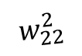
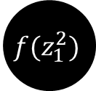
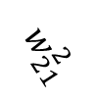

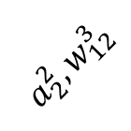
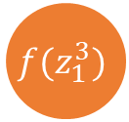
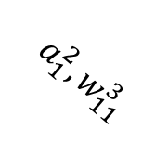
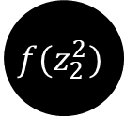
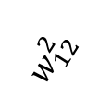
Neural Network: MLP Architecture
x1
$$w_{11}^{2}$$
$$f(z_{1}^{2})$$
$$a_{1}^{2},w_{11}^{3}$$
$$w_{12}^{2}$$
$$f(z_{1}^{3})$$
$$w_{21}^{2}$$
$$a_{2}^{2},w_{12}^{3}$$
$$f(z_{2}^{2})$$
x2
$$w_{22}^{2}$$
Output Layer
Input Layer
Hidden Layer

Slide 29
Neural Network: What is estimated?
x1
$$w_{11}^{2}$$
$$f(z_{1}^{2})$$
$$a_{1}^{2},w_{11}^{3}$$
$$w_{12}^{2}$$
$$f(z_{1}^{3})$$
$$w_{21}^{2}$$
$$a_{2}^{2},w_{12}^{3}$$
$$f(z_{2}^{2})$$
x2
$$w_{22}^{2}$$

Slide 30
Neural Network: What is estimated?
x1
$$w_{11}^{2}$$
$$f(z_{1}^{2})$$
Iteration 1
$$a_{1}^{2},w_{11}^{3}$$
$$w_{12}^{2}$$
X1 | X2 | Prediction | Actual
1 | 5 | 1 | 0
2 | 6 | 0 | 1
3 | 7 | 1 | 0
4 | 8 | 0 | 1
$$f(z_{1}^{3})$$
$$w_{21}^{2}$$
$$a_{2}^{2},w_{12}^{3}$$
$$f(z_{2}^{2})$$
x2
$$w_{22}^{2}$$

Slide 31
Neural Network: What is estimated?
x1
$$w_{11}^{2}$$
$$f(z_{1}^{2})$$
Iteration 2
$$a_{1}^{2},w_{11}^{3}$$
$$w_{12}^{2}$$
X1 | X2 | Prediction | Actual
1 | 5 | 0 | 0
2 | 6 | 1 | 1
3 | 7 | 1 | 0
4 | 8 | 0 | 1
$$f(z_{1}^{3})$$
$$w_{21}^{2}$$
$$a_{2}^{2},w_{12}^{3}$$
$$f(z_{2}^{2})$$
x2
$$w_{22}^{2}$$

Slide 32
Neural Network: What is estimated?
x1
$$w_{11}^{2}$$
$$f(z_{1}^{2})$$
Iteration 3
$$a_{1}^{2},w_{11}^{3}$$
$$w_{12}^{2}$$
X1 | X2 | Prediction | Actual
1 | 5 | 0 | 0
2 | 6 | 1 | 1
3 | 7 | 0 | 0
4 | 8 | 0 | 1
$$f(z_{1}^{3})$$
$$w_{21}^{2}$$
$$a_{2}^{2},w_{12}^{3}$$
$$f(z_{2}^{2})$$
x2
$$w_{22}^{2}$$

Slide 33
Neural Network: What is estimated?
x1
$$w_{11}^{2}$$
$$f(z_{1}^{2})$$
Iteration n
$$a_{1}^{2},w_{11}^{3}$$
$$w_{12}^{2}$$
X1 | X2 | Prediction | Actual
1 | 5 | 0 | 0
2 | 6 | 1 | 1
3 | 7 | 0 | 0
4 | 8 | 1 | 1
$$f(z_{1}^{3})$$
$$w_{21}^{2}$$
$$a_{2}^{2},w_{12}^{3}$$
$$f(z_{2}^{2})$$
x2
$$w_{22}^{2}$$

Slide 34
Neural Network: Loss Functions
To find optimum weights, Neural Networks optimize a loss function
Two most common tasks done by Neural Networks:
Regression
Classification
For regression problems, the loss function minimized is RSS
For classification problems, the loss function minimized is Cross Entropy loss

Slide 35
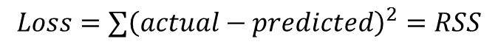
Neural Network: Loss Functions
Age
$$w_{11}^{2}$$
$$f(z_{1}^{2})$$
Regression
$$a_{1}^{2},w_{11}^{3}$$
$$w_{12}^{2}$$
Age | Income | Expenses | Pred | Error
20 | 30 | 300 | 420 | -120
35 | 64 | 600 | 500 | 100
…. | …. | …. | …. | …..
…. | …. | …. | …. | …..
…. | …. | …. | …. | …..
$$f(z_{1}^{3})$$
$$w_{21}^{2}$$
$$a_{2}^{2},w_{12}^{3}$$
$$f(z_{2}^{2})$$
Income
$$w_{22}^{2}$$
$$Loss=∑{\left(actual−predicted\right)}^{2}=RSS$$

Slide 36
Neural Network: Loss Functions
How does a neural network classifier works?

Slide 37
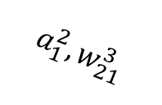

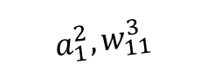
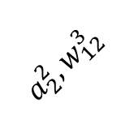
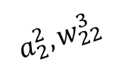


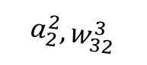
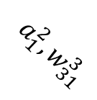
Neural Network: Loss Functions
$$a_{1}^{2},w_{11}^{3}$$
$$P_{C1}$$
x1
$$w_{11}^{2}$$
$$f(z_{1}^{2})$$
$$a_{1}^{2},w_{21}^{3}$$
$$w_{12}^{2}$$
$$P_{C2}$$
$$a_{2}^{2},w_{12}^{3}$$
$$w_{21}^{2}$$
$$a_{2}^{2},w_{22}^{3}$$
$$a_{1}^{2},w_{31}^{3}$$
$$f(z_{2}^{2})$$
x2
$$w_{22}^{2}$$
$$a_{2}^{2},w_{32}^{3}$$
$$P_{C3}$$
Classification Problem
Three Class Problem

Slide 38
Neural Network: Loss Functions
$$a_{1}^{2},w_{11}^{3}$$
$$P_{C1}$$
x1
$$w_{11}^{2}$$
$$f(z_{1}^{2})$$
$$a_{1}^{2},w_{21}^{3}$$
$$w_{12}^{2}$$
$$P_{C2}$$
Softmax Layer
$$a_{2}^{2},w_{12}^{3}$$
$$w_{21}^{2}$$
$$a_{2}^{2},w_{22}^{3}$$
$$a_{1}^{2},w_{31}^{3}$$
$$f(z_{2}^{2})$$
x2
$$w_{22}^{2}$$
$$a_{2}^{2},w_{32}^{3}$$
$$P_{C3}$$
Classification Problem
Three Class Problem

Slide 39
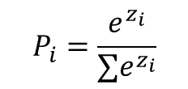
Neural Network: Loss Functions
$$a_{1}^{2},w_{11}^{3}$$
$$P_{C1}$$
x1
$$w_{11}^{2}$$
$$f(z_{1}^{2})$$
$$a_{1}^{2},w_{21}^{3}$$
$$w_{12}^{2}$$
$$P_{C2}$$
$$P_{i}=\frac{e^{z_{i}}}{∑e^{z_{i}}}$$
$$a_{2}^{2},w_{12}^{3}$$
$$w_{21}^{2}$$
$$a_{2}^{2},w_{22}^{3}$$
$$a_{1}^{2},w_{31}^{3}$$
$$f(z_{2}^{2})$$
x2
$$w_{22}^{2}$$
$$a_{2}^{2},w_{32}^{3}$$
$$P_{C3}$$
Classification Problem
Three Class Problem

Slide 40




Neural Network: Loss Functions
Row1
Prediction
Actual
$$a_{1}^{2},w_{11}^{3}$$
$$P_{C1}$$
x1
$$w_{11}^{2}$$
0.20
1
$$f(z_{1}^{2})$$
$$a_{1}^{2},w_{21}^{3}$$
$$w_{12}^{2}$$
$$P_{C2}$$
0.70
0
$$a_{2}^{2},w_{12}^{3}$$
$$w_{21}^{2}$$
$$a_{2}^{2},w_{22}^{3}$$
$$a_{1}^{2},w_{31}^{3}$$
$$f(z_{1}^{2})$$
x2
$$w_{22}^{2}$$
$$a_{2}^{2},w_{32}^{3}$$
$$P_{C3}$$
0.10
0
Classification Problem
Three Class Problem

Slide 41
Neural Network: Loss Functions
Row1
Row2
Prediction
Actual
Actual
$$a_{1}^{2},w_{11}^{3}$$
$$P_{C1}$$
x1
$$w_{11}^{2}$$
0.20
1
0
$$f(z_{1}^{2})$$
$$a_{1}^{2},w_{21}^{3}$$
$$w_{12}^{2}$$
$$P_{C2}$$
0.70
0
1
$$a_{2}^{2},w_{12}^{3}$$
$$w_{21}^{2}$$
$$a_{2}^{2},w_{22}^{3}$$
$$a_{1}^{2},w_{31}^{3}$$
$$f(z_{2}^{2})$$
x2
$$w_{22}^{2}$$
$$a_{2}^{2},w_{32}^{3}$$
$$P_{C3}$$
0.10
0
0
Classification Problem
Three Class Problem

Slide 42

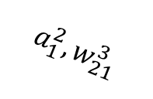


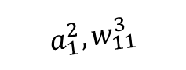










Neural Network: Loss Functions
Row1
Row2
Prediction
Actual
Actual
Error
$$P_{C1}$$
x1
$$w_{11}^{2}$$
$$a_{1}^{2},w_{11}^{3}$$
0.20
1
0
More/Less
$$f(z_{1}^{2})$$
$$a_{1}^{2},w_{21}^{3}$$
$$w_{12}^{2}$$
$$P_{C2}$$
0.70
0
1
$$a_{1}^{2},w_{31}^{3}$$
$$a_{2}^{2},w_{12}^{3}$$
$$w_{21}^{2}$$
$$a_{2}^{2},w_{22}^{3}$$
$$f(z_{2}^{2})$$
x2
$$w_{22}^{2}$$
$$a_{2}^{2},w_{32}^{3}$$
$$P_{C3}$$
0.10
0
0
Classification Problem
Three Class Problem

Slide 43
Neural Network: Loss Functions
Row1
Row2
Prediction
Actual
Actual
Error
$$P_{C1}$$
x1
$$w_{11}^{2}$$
$$a_{1}^{2},w_{11}^{3}$$
0.20
1
0
More/Less
$$f(z_{1}^{2})$$
$$a_{1}^{2},w_{21}^{3}$$
$$w_{12}^{2}$$
$$P_{C2}$$
0.70
0
1
$$a_{1}^{2},w_{31}^{3}$$
$$a_{2}^{2},w_{12}^{3}$$
$$w_{21}^{2}$$
$$a_{2}^{2},w_{22}^{3}$$
$$f(z_{2}^{2})$$
x2
$$w_{22}^{2}$$
$$a_{2}^{2},w_{32}^{3}$$
$$P_{C3}$$
0.10
0
0
Classification Problem
Three Class Problem

Slide 44

Neural Network: Loss Functions
Row1
Prediction
Actual
$$P_{C1}$$
x1
$$w_{11}^{2}$$
$$a_{1}^{2},w_{11}^{3}$$
0.20
1
$$f(z_{1}^{2})$$
$$a_{1}^{2},w_{21}^{3}$$
$$w_{12}^{2}$$
$$P_{C2}$$
0.70
0
$$a_{1}^{2},w_{31}^{3}$$
$$a_{2}^{2},w_{12}^{3}$$
$$w_{21}^{2}$$
$$a_{2}^{2},w_{22}^{3}$$
$$f(z_{2}^{2})$$
x2
$$w_{22}^{2}$$
$$a_{2}^{2},w_{32}^{3}$$
$$P_{C3}$$
0.10
0
Classification Problem
Three Class Problem
$$Loss Per Input=−∑y_{j}log⁡(p_{j})$$
-$\left[1∗\log\left(0.20\right)+0∗\log\left(0.70\right)+0∗\log\left(0.10\right)\right]=0.69$

Slide 45


Neural Network: Loss Functions
$$y_{i1}$$ | $$y_{i2}$$ | $$y_{i3}$$ | $$p_{i1}$$ | $$p_{i2}$$ | $$p_{i3}$$ | $$\sum_{j=1}^{3}{y_{j}log⁡(p_{j})}$$
1 | 0 | 0 | 0.8 | 0.1 | 0.1 | 0.22
0 | 1 | 0 | 0.2 | 0.7 | 0.1 | 0.35
0 | 0 | 1 | 0.05 | 0.05 | 0.9 | 0.10
 |  |  |  |  |  | 0.68
$$CE=−\sum_{i=1}^{n}{ }\sum_{j=1}^{k}{y_{ij}log⁡(p_{ij})}$$

Slide 46
Neural Networks: Training
x1
$$w_{11}^{2}$$
How many parameters this model has?
$$f(z_{1}^{2})$$
$$a_{1}^{2},w_{11}^{3}$$
$$w_{12}^{2}$$
$$f(z_{1}^{3})$$
$$w_{21}^{2}$$
$$a_{2}^{2},w_{12}^{3}$$
$$f(z_{2}^{2})$$
x2
$$w_{22}^{2}$$

Slide 47
Neural Networks: Training
x1
$$w_{11}^{2}$$
How many parameters this model has?
$$f(z_{1}^{2})$$
$$a_{1}^{2},w_{11}^{3}$$
$$w_{12}^{2}$$
$$f(z_{1}^{3})$$
4 weight terms
2 intercept
Layer 2
$$w_{21}^{2}$$
$$a_{2}^{2},w_{12}^{3}$$
$$f(z_{2}^{2})$$
x2
$$w_{22}^{2}$$

Slide 48




Neural Networks: Training
x1
$$w_{11}^{2}$$
How many parameters this model has?
$$f(z_{1}^{2})$$
$$a_{1}^{2},$$
$$w_{11}^{3}$$
$$w_{12}^{2}$$
$$f(z_{1}^{3})$$
2 weight terms
1 intercept
$$w_{12}^{3}$$
$$w_{21}^{2}$$
$$a_{2}^{2},$$
$$f(z_{2}^{2})$$
x2
$$w_{22}^{2}$$

Slide 49
Neural Networks: Training
x1
$$w_{11}^{2}$$
How many parameters this model has?
$$f(z_{1}^{2})$$
$$a_{1}^{2},w_{11}^{3}$$
4+2 in layer 2
2+1 in last layer
$$w_{12}^{2}$$
$$f(z_{1}^{3})$$
$$w_{21}^{2}$$
$$a_{2}^{2},w_{12}^{3}$$
$$f(z_{2}^{2})$$
x2
$$w_{22}^{2}$$

Slide 50
Neural Networks: Training
x1
$$w_{11}^{2}$$
How many parameters this model has?
$$f(z_{1}^{2})$$
$$a_{1}^{2},w_{11}^{3}$$
4+2 in layer 2
2+1 in last layer
$$w_{12}^{2}$$
$$f(z_{1}^{3})$$
How will these parameters be estimated?
$$w_{21}^{2}$$
$$a_{2}^{2},w_{12}^{3}$$
$$f(z_{2}^{2})$$
x2
$$w_{22}^{2}$$

Slide 51
Neural Networks: Training
x1
$$w_{11}^{2}$$
How many parameters this model has?
$$f(z_{1}^{2})$$
$$a_{1}^{2},w_{11}^{3}$$
4+2 in layer 2
2+1 in last layer
$$w_{12}^{2}$$
$$f(z_{1}^{3})$$
How will these parameters be estimated?
$$w_{21}^{2}$$
$$a_{2}^{2},w_{12}^{3}$$
$$f(z_{2}^{2})$$
Choose parameters which minimize the cost: RSS or Cross-Entropy
x2
$$w_{22}^{2}$$

Slide 52
Neural Networks: Training
x1
$$w_{11}^{2}$$
How many parameters this model has?
$$f(z_{1}^{2})$$
$$a_{1}^{2},w_{11}^{3}$$
4+2 in layer 2
2+1 in last layer
$$w_{12}^{2}$$
$$f(z_{1}^{3})$$
How will these parameters be estimated?
$$w_{21}^{2}$$
$$a_{2}^{2},w_{12}^{3}$$
$$f(z_{2}^{2})$$
Choose parameters which minimize the cost: RSS or Cross-Entropy
x2
$$w_{22}^{2}$$
How?

Slide 53
Neural Networks: Training
x1
$$w_{11}^{2}$$
How many parameters this model has?
$$f(z_{1}^{2})$$
$$a_{1}^{2},w_{11}^{3}$$
4+2 in layer 2
2+1 in last layer
$$w_{12}^{2}$$
$$f(z_{1}^{3})$$
How will these parameters be estimated?
$$w_{21}^{2}$$
$$a_{2}^{2},w_{12}^{3}$$
$$f(z_{2}^{2})$$
Choose parameters which minimize the cost: RSS or Cross-Entropy
x2
$$w_{22}^{2}$$
How?
Gradient Descent

Slide 54
Neural Networks: Training
Age
$$w_{11}^{2}$$
$$f(z_{1}^{2})$$
Regression
$$a_{1}^{2},w_{11}^{3}$$
$$w_{12}^{2}$$
Age | Income | Expenses | Pred | Error
20 | 30 | 300 | 420 | -120
35 | 64 | 600 | 500 | 100
…. | …. | …. | …. | …..
…. | …. | …. | …. | …..
…. | …. | …. | …. | …..
$$f(z_{1}^{3})$$
$$w_{21}^{2}$$
$$a_{2}^{2},w_{12}^{3}$$
$$f(z_{2}^{2})$$
Income
$$w_{22}^{2}$$
$$Loss=∑{\left(actual−predicted\right)}^{2}=RSS$$

Slide 55

Neural Networks: Training
x1
$$w_{11}^{2}$$
$$f(z_{1}^{2})$$
$$a_{1}^{2},w_{11}^{3}$$
$$w_{12}^{2}$$
$$f(z_{1}^{3})$$
$$a^{3}$$
$$w_{21}^{2}$$
$$a_{2}^{2},w_{12}^{3}$$
$$f(z_{2}^{2})$$
x2
$$w_{22}^{2}$$

Slide 56

Neural Networks: Training
x1
$$w_{11}^{2}$$
$$f(z_{1}^{2})$$
$$a_{1}^{2},w_{11}^{3}$$
$$w_{12}^{2}$$
$$f(z_{1}^{3})$$
$$a^{3}$$
$$RSS={∑\left(actual−a^{3}\right)}^{2}$$
$$w_{21}^{2}$$
$$a_{2}^{2},w_{12}^{3}$$
$$f(z_{2}^{2})$$
x2
$$w_{22}^{2}$$

Slide 57

Neural Networks: Training
x1
$$w_{11}^{2}$$
$$f(z_{1}^{2})$$
$$a_{1}^{2},w_{11}^{3}$$
$$w_{12}^{2}$$
$$f(z_{1}^{3})$$
$$a^{3}$$
$$RSS={∑\left(actual−a^{3}\right)}^{2}$$
$$w_{21}^{2}$$
$$a_{2}^{2},w_{12}^{3}$$
$$a^{3}=w_{0}^{3}+w_{11}^{3}∗a_{1}^{2}+w_{12}^{3}∗a_{2}^{2}$$
$$f(z_{2}^{2})$$
x2
$$w_{22}^{2}$$

Slide 58

Neural Networks: Training
x1
$$w_{11}^{2}$$
To do Gradient Descent we will need to update all the parameters using the rule:
$$w_{kJ}^{n}≔w_{kj}^{n}−η\frac{∂RSS}{∂w_{kj}^{n}}$$
$$f(z_{1}^{2})$$
$$a_{1}^{2},w_{11}^{3}$$
$$w_{12}^{2}$$
$$f(z_{1}^{3})$$
$$a^{3}$$
$$RSS={∑\left(actual−a^{3}\right)}^{2}$$
$$w_{21}^{2}$$
$$a_{2}^{2},w_{12}^{3}$$
$$a^{3}=w_{0}^{3}+w_{11}^{3}∗a_{1}^{2}+w_{12}^{3}∗a_{2}^{2}$$
$$f(z_{2}^{2})$$
x2
$$w_{22}^{2}$$

Slide 59







Neural Networks: Training
x1
$$w_{11}^{2}$$
To do Gradient Descent we will need to update all the parameters using the rule:
$$w_{kJ}^{n}≔w_{kj}^{n}−η\frac{∂RSS}{∂w_{kj}^{n}}$$
$$f(z_{1}^{2})$$
$$a_{1}^{2},$$
$$w_{11}^{3}$$
$$w_{12}^{2}$$
$$f(z_{1}^{3})$$
$$a^{3}$$
$$w_{12}^{3}$$
$$w_{21}^{2}$$
$$a_{2}^{2},$$
$$w_{0}^{3}≔w_{0}^{3}−η\frac{∂RSS}{∂w_{0}^{3}}$$
$$w_{11}^{3}≔w_{11}^{3}−η\frac{∂RSS}{∂w_{11}^{3}}$$
$$w_{12}^{3}≔w_{12}^{3}−η\frac{∂RSS}{∂w_{12}^{3}}$$
$$f(z_{2}^{2})$$
x2
$$w_{22}^{2}$$
$$RSS={∑\left(actual−a^{3}\right)}^{2}$$
$$a^{3}=w_{0}^{3}+w_{11}^{3}∗a_{1}^{2}+w_{12}^{3}∗a_{2}^{2}$$

Slide 60

Neural Networks: Training
x1
$$w_{11}^{2}$$
To do Gradient Descent we will need to update all the parameters using the rule:
$$w_{kJ}^{n}≔w_{kj}^{n}−η\frac{∂RSS}{∂w_{kj}^{n}}$$
$$f(z_{1}^{2})$$
$$a_{1}^{2},w_{11}^{3}$$
$$w_{12}^{2}$$
$$f(z_{1}^{3})$$
$$a^{3}$$
$$w_{21}^{2}$$
$$a_{2}^{2},w_{12}^{3}$$
$$w_{11}^{2} :=w_{11}^{2}−η\frac{∂RSS}{∂w_{11}^{2}}$$
$$w_{12}^{2} :=w_{12}^{2}−η\frac{∂RSS}{∂w_{12}^{2}}$$
………
$$f(z_{2}^{2})$$
x2
$$w_{22}^{2}$$
$$RSS={∑\left(actual−a^{3}\right)}^{2}$$
$$a^{3}=w_{0}^{3}+w_{11}^{3}∗a_{1}^{2}+w_{12}^{3}∗a_{2}^{2}$$

Slide 61









Neural Networks: Training
x1
$$w_{11}^{2}$$
$$f(z_{1}^{2})$$
X1 | X2 | Y
… | … | …
… | … | …
… | … | …
$$a_{1}^{2},w_{11}^{3}$$
Prediction
…
…
…
$$w_{12}^{2}$$
$$f(z_{1}^{3})$$
$$w_{21}^{2}$$
$$a_{2}^{2},w_{12}^{3}$$
$$f(z_{2}^{2})$$
x2
$$w_{22}^{2}$$

Slide 62
Neural Networks: Training
x1
$$w_{11}^{2}$$
$$f(z_{1}^{2})$$
X1 | X2 | Y
… | … | …
… | … | …
… | … | …
$$a_{1}^{2},w_{11}^{3}$$
Prediction
…
…
…
$$w_{12}^{2}$$
$$f(z_{1}^{3})$$
$$w_{21}^{2}$$
$$a_{2}^{2},w_{12}^{3}$$
$$f(z_{2}^{2})$$
x2
$$w_{22}^{2}$$

Slide 63
Neural Networks: Training
x1
$$w_{11}^{2}$$
$$f(z_{1}^{2})$$
X1 | X2 | Y
… | … | …
… | … | …
… | … | …
$$a_{1}^{2},w_{11}^{3}$$
Prediction
…
…
…
$$w_{12}^{2}$$
$$f(z_{1}^{3})$$
$$w_{21}^{2}$$
$$a_{2}^{2},w_{12}^{3}$$
$$f(z_{2}^{2})$$
x2
$$w_{22}^{2}$$
Forward Pass

Slide 64

Neural Networks: Training
x1
$$w_{11}^{2}$$
$$f(z_{1}^{2})$$
X1 | X2 | Y
… | … | …
… | … | …
… | … | …
$$a_{1}^{2},w_{11}^{3}$$
Prediction
…
…
…
$$w_{12}^{2}$$
$$f(z_{1}^{3})$$
$$w_{21}^{2}$$
$$a_{2}^{2},w_{12}^{3}$$
$$f(z_{2}^{2})$$
x2
$$w_{22}^{2}$$
$$w_{kJ}^{n}≔w_{kj}^{n}−η\frac{∂RSS}{∂w_{kj}^{n}}$$
Backward Pass

Slide 65







Neural Networks: Training
x1
$$w_{11}^{2}$$
$$f(z_{1}^{2})$$
X1 | X2 | Y
… | … | …
… | … | …
… | … | …
$$a_{1}^{2},w_{11}^{3}$$
Prediction
…
…
…
$$w_{12}^{2}$$
$$f(z_{1}^{3})$$
$$w_{21}^{2}$$
$$a_{2}^{2},w_{12}^{3}$$
$$f(z_{2}^{2})$$
x2
$$w_{22}^{2}$$
$$w_{kJ}^{n}≔w_{kj}^{n}−η\frac{∂RSS}{∂w_{kj}^{n}}$$
Backward Pass

Slide 66
Neural Networks: Training
x1
$$w_{11}^{2}$$
$$f(z_{1}^{2})$$
X1 | X2 | Y
… | … | …
… | … | …
… | … | …
$$a_{1}^{2},w_{11}^{3}$$
Prediction
…
…
…
$$w_{12}^{2}$$
$$f(z_{1}^{3})$$
$$w_{21}^{2}$$
$$a_{2}^{2},w_{12}^{3}$$
$$f(z_{2}^{2})$$
x2
$$w_{22}^{2}$$

Slide 67
Neural Networks: Training
x1
$$w_{11}^{2}$$
$$f(z_{1}^{2})$$
X1 | X2 | Y
… | … | …
… | … | …
… | … | …
$$a_{1}^{2},w_{11}^{3}$$
Prediction
…
…
…
$$w_{12}^{2}$$
$$f(z_{1}^{3})$$
$$w_{21}^{2}$$
$$a_{2}^{2},w_{12}^{3}$$
$$f(z_{2}^{2})$$
x2
$$w_{22}^{2}$$
Forward Pass

Slide 68
Neural Networks: Training
x1
$$w_{11}^{2}$$
$$f(z_{1}^{2})$$
X1 | X2 | Y
… | … | …
… | … | …
… | … | …
$$a_{1}^{2},w_{11}^{3}$$
Prediction
…
…
…
$$w_{12}^{2}$$
$$f(z_{1}^{3})$$
$$w_{21}^{2}$$
$$a_{2}^{2},w_{12}^{3}$$
$$f(z_{2}^{2})$$
x2
$$w_{22}^{2}$$
$$w_{kJ}^{n}≔w_{kj}^{n}−η\frac{∂RSS}{∂w_{kj}^{n}}$$
Backward Pass

Slide 69
Neural Networks: Training
x1
$$w_{11}^{2}$$
$$f(z_{1}^{2})$$
X1 | X2 | Y
… | … | …
… | … | …
… | … | …
$$a_{1}^{2},w_{11}^{3}$$
Prediction
…
…
…
$$w_{12}^{2}$$
$$f(z_{1}^{3})$$
$$w_{21}^{2}$$
$$a_{2}^{2},w_{12}^{3}$$
$$f(z_{2}^{2})$$
x2
$$w_{22}^{2}$$
$$w_{kJ}^{n}≔w_{kj}^{n}−η\frac{∂RSS}{∂w_{kj}^{n}}$$
Backward Pass

Slide 70
Neural Networks: Training
x1
$$w_{11}^{2}$$
$$f(z_{1}^{2})$$
X1 | X2 | Y
… | … | …
… | … | …
… | … | …
$$a_{1}^{2},w_{11}^{3}$$
Prediction
…
…
…
$$w_{12}^{2}$$
$$f(z_{1}^{3})$$
$$w_{21}^{2}$$
$$a_{2}^{2},w_{12}^{3}$$
$$f(z_{2}^{2})$$
x2
$$w_{22}^{2}$$

Slide 71
Neural Networks: Training
x1
$$w_{11}^{2}$$
$$f(z_{1}^{2})$$
X1 | X2 | Y
… | … | …
… | … | …
… | … | …
$$a_{1}^{2},w_{11}^{3}$$
Prediction
…
…
…
$$w_{12}^{2}$$
$$f(z_{1}^{3})$$
$$w_{21}^{2}$$
$$a_{2}^{2},w_{12}^{3}$$
$$f(z_{2}^{2})$$
x2
$$w_{22}^{2}$$
Forward Pass

Slide 72
Neural Networks: Training
x1
$$w_{11}^{2}$$
$$f(z_{1}^{2})$$
X1 | X2 | Y
… | … | …
… | … | …
… | … | …
$$a_{1}^{2},w_{11}^{3}$$
Prediction
…
…
…
$$w_{12}^{2}$$
$$f(z_{1}^{3})$$
$$w_{21}^{2}$$
$$a_{2}^{2},w_{12}^{3}$$
$$f(z_{2}^{2})$$
x2
$$w_{22}^{2}$$
$$w_{kJ}^{n}≔w_{kj}^{n}−η\frac{∂RSS}{∂w_{kj}^{n}}$$
Backward Pass

Slide 73
Neural Networks: Training
x1
$$w_{11}^{2}$$
$$f(z_{1}^{2})$$
X1 | X2 | Y
… | … | …
… | … | …
… | … | …
$$a_{1}^{2},w_{11}^{3}$$
Prediction
…
…
…
$$w_{12}^{2}$$
$$f(z_{1}^{3})$$
$$w_{21}^{2}$$
$$a_{2}^{2},w_{12}^{3}$$
$$f(z_{2}^{2})$$
x2
$$w_{22}^{2}$$
$$w_{kJ}^{n}≔w_{kj}^{n}−η\frac{∂RSS}{∂w_{kj}^{n}}$$
Backward Pass

Slide 74
Neural Networks: Training
x1
$$w_{11}^{2}$$
To do Gradient Descent we will need to update all the parameters using the rule:
$$w_{kJ}^{n}≔w_{kj}^{n}−η\frac{∂RSS}{∂w_{kj}^{n}}$$
$$f(z_{1}^{2})$$
$$a_{1}^{2},$$
$$w_{11}^{3}$$
$$w_{12}^{2}$$
$$f(z_{1}^{3})$$
$$a^{3}$$
$$w_{12}^{3}$$
$$w_{21}^{2}$$
$$a_{2}^{2},$$
$$w_{0}^{3}≔w_{0}^{3}−η\frac{∂RSS}{∂w_{0}^{3}}$$
$$w_{11}^{3}≔w_{11}^{3}−η\frac{∂RSS}{∂w_{11}^{3}}$$
$$w_{12}^{3}≔w_{12}^{3}−η\frac{∂RSS}{∂w_{12}^{3}}$$
$$f(z_{2}^{2})$$
x2
$$w_{22}^{2}$$
$$RSS={∑\left(actual−a^{3}\right)}^{2}$$
$$a^{3}=w_{0}^{3}+w_{11}^{3}∗a_{1}^{2}+w_{12}^{3}∗a_{2}^{2}$$

Slide 75
Neural Networks: Backpropagation
x1
$$w_{11}^{2}$$
To do Gradient Descent we will need to update all the parameters using the rule:
$$w_{kJ}^{n}≔w_{kj}^{n}−η\frac{∂RSS}{∂w_{kj}^{n}}$$
$$f(z)$$
$$a_{1}^{2},$$
$$w_{11}^{3}$$
$$w_{12}^{2}$$
$$f(z)$$
$$a^{3}$$
$$w_{12}^{3}$$
$$w_{21}^{2}$$
$$a_{2}^{2},$$
$$f(z)$$
$$w_{0}^{3}≔w_{0}^{3}−η\frac{∂RSS}{∂w_{0}^{3}}=w_{0}^{3}−η2∑\left(actual−a^{3}\right)∗\frac{∂a^{3}}{∂w_{0}}$$
$$w_{11}^{3}≔w_{11}^{3}−η\frac{∂RSS}{∂w_{11}^{3}}=w_{11}^{3}−η2∑\left(actual−a^{3}\right)∗\frac{∂a^{3}}{∂w_{11}}$$
$$w_{12}^{3}≔w_{12}^{3}−η\frac{∂RSS}{∂w_{12}^{3}}=w_{12}^{3}−η2∑\left(actual−a^{3}\right)∗\frac{∂a^{3}}{∂w_{13}}$$
x2
$$w_{22}^{2}$$
$$RSS={∑\left(actual−a^{3}\right)}^{2}$$
$$a^{3}=w_{0}^{3}+w_{11}^{3}∗a_{1}^{2}+w_{12}^{3}∗a_{2}^{2}$$

Slide 76
Neural Networks: Backpropagation
x1
$$w_{11}^{2}$$
To do Gradient Descent we will need to update all the parameters using the rule:
$$w_{kJ}^{n}≔w_{kj}^{n}−η\frac{∂RSS}{∂w_{kj}^{n}}$$
$$f(z)$$
$$a_{1}^{2},$$
$$w_{11}^{3}$$
$$w_{12}^{2}$$
$$f(z)$$
$$a^{3}$$
$$w_{12}^{3}$$
$$w_{21}^{2}$$
$$a_{2}^{2},$$
$$f(z)$$
$$w_{0}^{3}≔w_{0}^{3}−η\frac{∂RSS}{∂w_{0}^{3}}=w_{0}^{3}−η2∑\left(actual−a^{3}\right)∗1$$
$$w_{11}^{3}≔w_{11}^{3}−η\frac{∂RSS}{∂w_{11}^{3}}=w_{11}^{3}−η2∑\left(actual−a^{3}\right)∗a_{1}^{2}$$
$$w_{12}^{3}≔w_{12}^{3}−η\frac{∂RSS}{∂w_{12}^{3}}=w_{12}^{3}−η2∑\left(actual−a^{3}\right)∗a_{2}^{2}$$
x2
$$w_{22}^{2}$$
$$RSS={∑\left(actual−a^{3}\right)}^{2}$$
$$a^{3}=w_{0}^{3}+w_{11}^{3}∗a_{1}^{2}+w_{12}^{3}∗a_{2}^{2}$$

Slide 77
Neural Networks: Backpropagation
x1
$$w_{11}^{2}$$
To do Gradient Descent we will need to update all the parameters using the rule:
$$w_{kJ}^{n}≔w_{kj}^{n}−η\frac{∂RSS}{∂w_{kj}^{n}}$$
$$f(z_{1}^{2})$$
$$a_{1}^{2},w_{11}^{3}$$
$$w_{12}^{2}$$
$$f(z_{1}^{3})$$
$$a^{3}$$
$$a_{2}^{2},w_{12}^{3}$$
$$\frac{∂RSS}{∂z_{1}^{3}}$$
$$w_{21}^{2}$$
$$f(z_{2}^{2})$$
x2
$$w_{22}^{2}$$

Slide 78
Neural Networks: Backpropagation
x1
$$w_{11}^{2}$$
To do Gradient Descent we will need to update all the parameters using the rule:
$$w_{kJ}^{n}≔w_{kj}^{n}−η\frac{∂RSS}{∂w_{kj}^{n}}$$
$$f(z_{1}^{2})$$
$$a_{1}^{2},w_{11}^{3}$$
$$w_{12}^{2}$$
$$f(z_{1}^{3})$$
$$a^{3}$$
$$a_{2}^{2},w_{12}^{3}$$
$$\frac{∂RSS}{∂z_{1}^{3}}$$
$$w_{21}^{2}$$
$$δ_{1}^{3}$$
$$f(z_{2}^{2})$$
x2
$$w_{22}^{2}$$

Slide 79
Neural Networks: Backpropagation
x1
$$w_{11}^{2}$$
To do Gradient Descent we will need to update all the parameters using the rule:
$$w_{kJ}^{n}≔w_{kj}^{n}−η\frac{∂RSS}{∂w_{kj}^{n}}$$
$$f(z_{1}^{2})$$
$$a_{1}^{2},w_{11}^{3}$$
$$w_{12}^{2}$$
$$f(z_{1}^{3})$$
$$a^{3}$$
$$a_{2}^{2},w_{12}^{3}$$
$$\frac{∂RSS}{∂z_{1}^{3}}$$
$$w_{21}^{2}$$
$$δ_{1}^{3}$$
$$f(z_{2}^{2})$$
x2
$$w_{22}^{2}$$
How cost is changing as input to final neuron changes

Slide 80

Neural Networks: Backpropagation
x1
$$w_{11}^{2}$$
To do Gradient Descent we will need to update all the parameters using the rule:
$$w_{kJ}^{n}≔w_{kj}^{n}−η\frac{∂RSS}{∂w_{kj}^{n}}$$
$$f(z_{1}^{2})$$
$$a_{1}^{2},w_{11}^{3}$$
$$w_{12}^{2}$$
$$f(z_{1}^{3})$$
$$a^{3}$$
$$a_{2}^{2},w_{12}^{3}$$
$$\frac{∂RSS}{∂z_{1}^{3}}$$
$$w_{21}^{2}$$
$$δ_{1}^{3}$$
$$f(z_{2}^{2})$$
x2
$$w_{22}^{2}$$
How cost is changing as input to final neuron changes
$$a^{3}−y$$

Slide 81


Neural Networks: Backpropagation
x1
$$w_{11}^{2}$$
To do Gradient Descent we will need to update all the parameters using the rule:
$$w_{kJ}^{n}≔w_{kj}^{n}−η\frac{∂RSS}{∂w_{kj}^{n}}$$
$$f(z_{1}^{2})$$
$$a_{1}^{2},w_{11}^{3}$$
$$w_{12}^{2}$$
$$f(z_{1}^{3})$$
$$a^{3}$$
$$a_{2}^{2},w_{12}^{3}$$
$$\frac{∂RSS}{∂w_{1}^{3}}$$
$$w_{21}^{2}$$
$${dw}_{1}^{3}$$
$$f(z_{2}^{2})$$
x2
$$w_{22}^{2}$$

Slide 82
Neural Networks: Backpropagation
x1
$$w_{11}^{2}$$
To do Gradient Descent we will need to update all the parameters using the rule:
$$w_{kJ}^{n}≔w_{kj}^{n}−η\frac{∂RSS}{∂w_{kj}^{n}}$$
$$f(z_{1}^{2})$$
$$a_{1}^{2},w_{11}^{3}$$
$$w_{12}^{2}$$
$$f(z_{1}^{3})$$
$$a^{3}$$
$$a_{2}^{2},w_{12}^{3}$$
$$\frac{∂RSS}{∂w_{1}^{3}}$$
$$w_{21}^{2}$$
$${dw}_{1}^{3}$$
$$f(z_{2}^{2})$$
x2
$$w_{22}^{2}$$
How cost is changing as weights to final neuron changes

Slide 83

Neural Networks: Backpropagation
x1
$$w_{11}^{2}$$
To do Gradient Descent we will need to update all the parameters using the rule:
$$w_{kJ}^{n}≔w_{kj}^{n}−η\frac{∂RSS}{∂w_{kj}^{n}}$$
$$f(z_{1}^{2})$$
$$a_{1}^{2},w_{11}^{3}$$
$$w_{12}^{2}$$
$$f(z_{1}^{3})$$
$$a^{3}$$
$$a_{2}^{2},w_{12}^{3}$$
$$\frac{∂RSS}{∂w_{1}^{3}}$$
$$w_{21}^{2}$$
$${dw}_{1}^{3}$$
$$f(z_{2}^{2})$$
x2
$$w_{22}^{2}$$
How cost is changing as weights to final neuron changes
$$a^{2}Tδ^{3}$$

Slide 84



Neural Networks: Backpropagation
x1
$$w_{11}^{2}$$
To do Gradient Descent we will need to update all the parameters using the rule:
$$w_{kJ}^{n}≔w_{kj}^{n}−η\frac{∂RSS}{∂w_{kj}^{n}}$$
$$f(z_{1}^{2})$$
$$a_{1}^{2},w_{11}^{3}$$
$$w_{12}^{2}$$
$$f(z_{1}^{3})$$
$$a^{3}$$
$$a_{2}^{2},w_{12}^{3}$$
$$\frac{∂RSS}{∂w_{0}^{3}}$$
$$w_{21}^{2}$$
$${db}_{1}^{3}$$
$$f(z_{2}^{2})$$
x2
$$w_{22}^{2}$$
How cost is changing as bias to final neuron changes
$${∑δ}^{3}$$

Slide 85

Neural Networks: Backpropagation
From the last layer:
Compute $δ=a−y$
Find $dw=a_{\left\{l−1\right\}}Tδ$
Find $db=\frac{∑δ}{n}$
For intermediate layers :
$δ_{l}=δ_{\left\{l+1\right\}}W_{\left\{l+1 \right\}}^{T}∘grad_activation$
Use this $δ$to compute $dw and db$

Slide 86
Neural Networks: Training
Forward and backward pass across whole data is termed as an epoch
Usually multiple epochs are done to train the network
Most Neural Net Frameworks give ability to do Forward/Backward Passes in a batch wise manner
One usually has to experiment with the values of epochs and batch size.

